Slide 1

The Machine Learning Process
How do I use string methods
in pandas?
Dr. Reza Dibaj

Slide 2

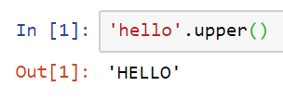
String methods in pandas
In Python, we are used to having access to a large number of string methods.
The same way, we have a lot of string methods that we need to know how to find them.
Notes:
'hello'.upper()

Slide 3
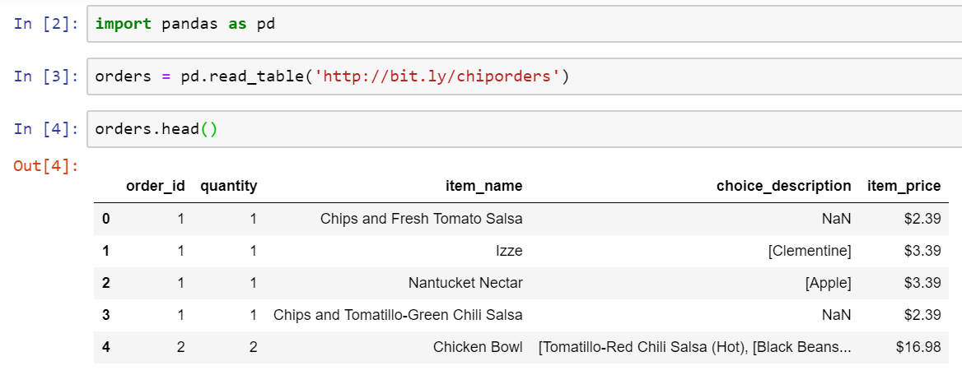
String methods in pandas
Let’s pull up an example dataset as follows:
(Online orders from Chipotle restaurant chain)
Notes:
import pandas as pd
orders = pd.read_table('http://bit.ly/chiporders’)
orders.head()

Slide 4
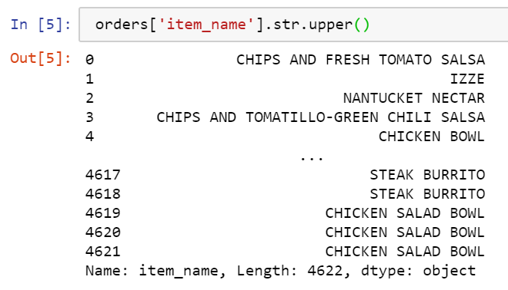
String methods in pandas
Imagine we want to make the item_name uppercase.
The following is how we do the job….
Notes:
orders['item_name'].str.upper()

Slide 5
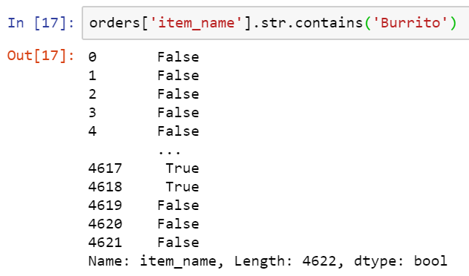
String methods in pandas
As another example imagine we want to find a substring inside a string, e.g. we are searching for item names which contain ‘’. We should use contains method as follows:
The result is a Series of Booleans indicating whether a particular item contains ‘Burrito’.
Notes:
orders['item_name'].str.contains('Burrito')

Slide 6
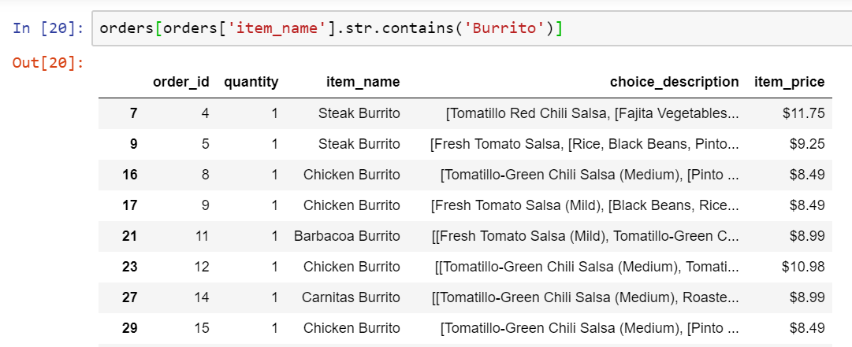
String methods in pandas
And this is how we can filter our DataFrame to show item_name items that contain ‘Burrito’.
Notes:
orders[orders['item_name'].str.contains('Burrito’)]

Slide 7

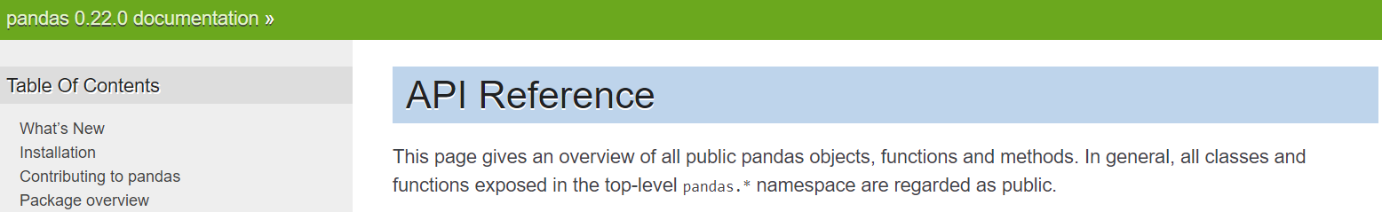
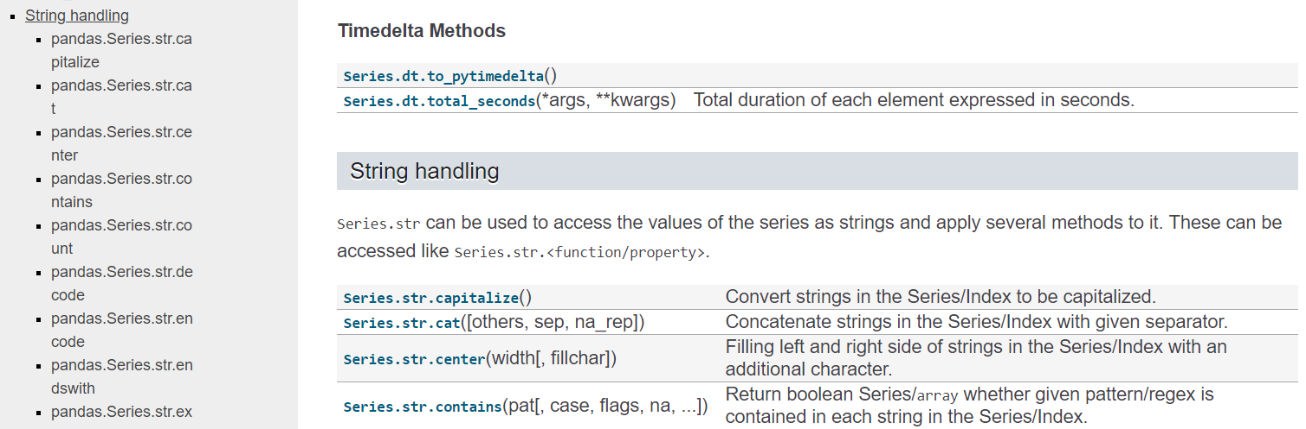
String methods in pandas
If you want to know more about pandas string methods, please google pandas API reference and you can find the following information:
Notes:
https://pandas.pydata.org/pandas-docs/version/0.22/api.html

Slide 8

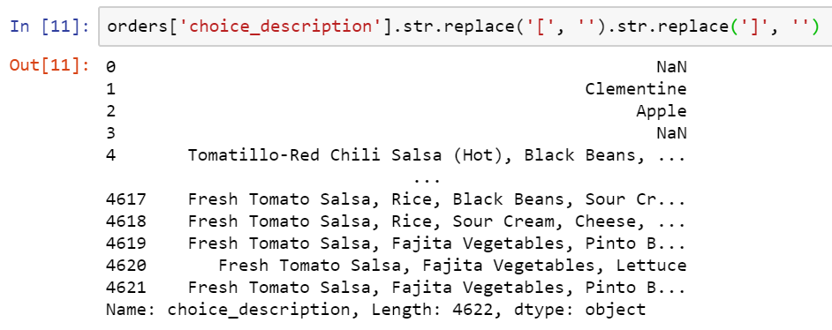
Bonus Tip
We can chain the string methods together.
For removing the brackets from the choice_description we can use the following commands:
pandas Series
Chaining another method
Notes:
orders['choice_description'].str.replace('[', '').str.replace(']', '')

Slide 9
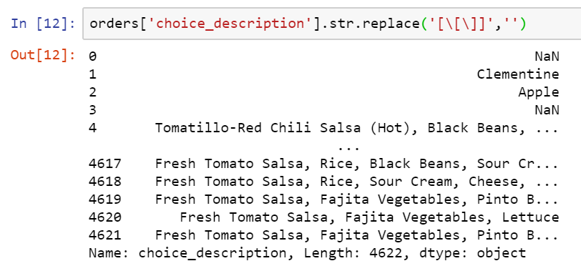
Bonus Tip
We can do the same task, using the regular expressions as follows:
Regular expression
Brackets that defines the character class
\[ \] means either left bracket or right bracket should be replaced by null.
Notes:
orders['choice_description'].str.replace('[\[\]]',‘’)

Slide 10

Thank you
Question?
To be
Not to be

